Slide 1

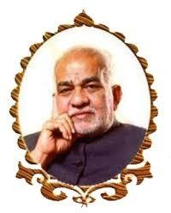
BVRIT HYDERABAD College of Engineering for Women
CSE [AI&ML]
Safe Bet
Team No: 4
BY:
G.Khyathi priya 21WH1A6616
B.Bhavana 21WH1A6615
T.Sahithya 21WH1A6617
BH.Manushree 21WH1A6618
G.Hasmitha 21WH1A6619
Under the guidance of :

Slide 2
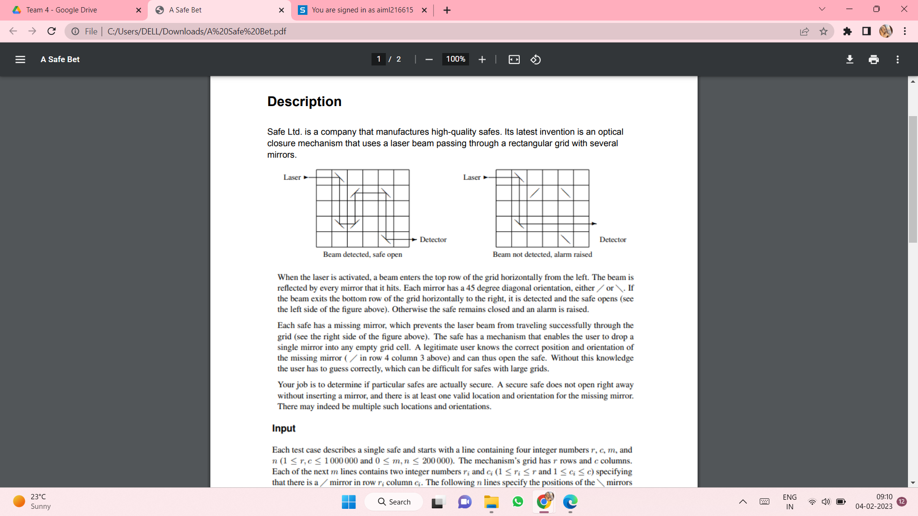
PROBLEM STATEMENT
When the laser is activated , a beam enters the top row of the grid horizontally from the left .
The beam is reflected by every mirror that it hits . Each mirror has a 45 degree diagonal orientation , either / or \ .
if the beam exits the bottom row of the grid horizontally to the right , it is detected and the safe opens otherwise the safe remains closed and an alarm is raised

Slide 3
Each grid has a missing mirror , which prevents the laser beam from travelling successfully through the grid , the safe has a mechanism which enables the user to drop the missing mirror in an empty grid cell . Only a legitimate user knows the correct position and orientation of the missing mirror and can open the safe
The job is to determine if a particular safe is actually secure . A secure safe does not open right away without inserting any mirror, and there is at least one valid location and orientation for the missing mirror .

Slide 4
INPUT STATEMENT
INPUT -
Each test case describes a single safe and starts with a line containing four integer numbers r,c,n,m
The mechanism grid has r rows and c columns . Each of the next m lines contains two integer numbers ri and ci , specifying that there is a / mirror in row ri and column ci .
The following n lines will specify the positions if the \ mirror in the same way
The m+n positions of the mirrors are pairwise distinct

Slide 5
OUTPUT
Output
For each test case , display its case number followed by :
0 if each case opens without inserting a mirror
K r c if the safe does not open without inserting a mirror , there are exactly K positions where inserting a mirror opens the safe , and (r,c) is the lexicographically smallest such row , column position . A position where both a/ and a \ mirror open the safe count just once .
impossible if the safe cannot be opened with or without inserting a mirror

Slide 6
SAMPLE INPUT AND OUTPUT
Sample input Output for Sample input
5 6 1 4 2 3 1 2 2 5 4 2 5 5 100 100 0 2 1 77 100 77 100 100 0 0 | Case 1: 2 4 3 Case 2: 0 case 3: impossible

Slide 7
Python Modules and Packages
Tkinter Turtle PIL | used to create Graphical User Interface(GUI) Used to draw the grid and tracing lines Used to load and display image

Slide 8
CODE
safe bet code - Jupyter Notebook

Slide 9
Contribution
Name | Roll-No | Contribution
B.Bhavana | 21WH1A6615 | Written code for front tracing and trace path , logo designing and PPT making
G.Khyathi Priya | 21WH1A6616 | Written code for point of intersection , back tracing, and GUI
T.Sahithya | 21WH1A6617 | Written code for move up and move down functions, gathered information for GUI
BH.Manusree | 21WH1A6618 | Written code for moving forward and moving backward , gathered information for GUI
G.Hasmitha | 21WH1A6619 | Written code for change direction function and main function , search references

Slide 10
References
GitHub -
https://github.com/amrit110/safe_problem/blob/master/main.py

Slide 11
THANK YOU

